Slide 1
Vehicle Door and Interior Defect Inspection and Quality Assurance
Student: 林正偉
0970911688
r10922102@ntu.edu.tw

Slide 2

Introduction
On the production line of the car, the common approach to check whether a car is non-defective is that every car will be transported through the production line one by one, and then move forward on the production line.
In the process of the inspection, the operator needs to establish a standard operating procedure to ensure that the inspection process of each vehicle is the same, so that the quality of each vehicle can be guaranteed to be consistent.

Slide 3
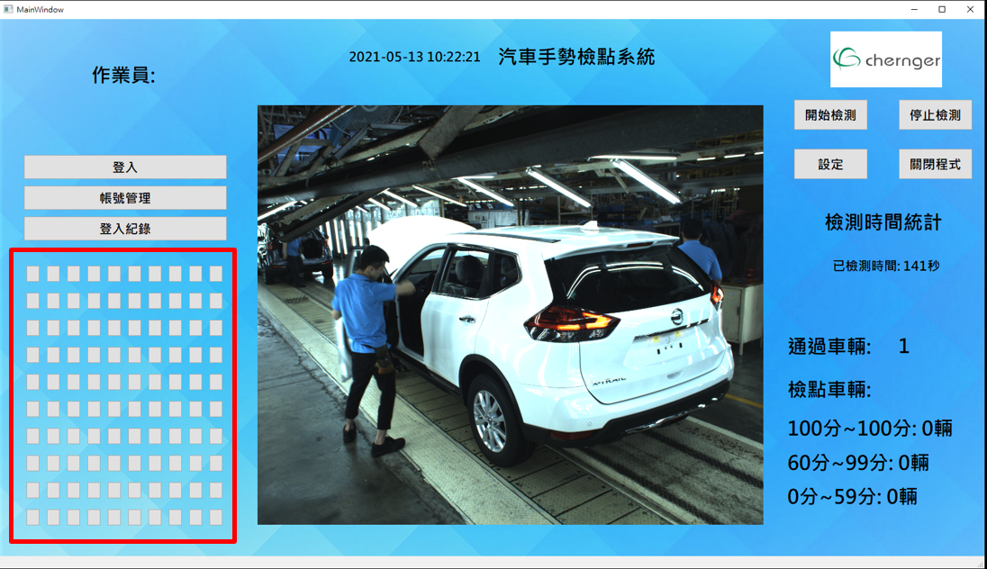
Introduction
The purpose of our research is to establish a testing system for quality control. This inspection system will confirm whether each vehicle on the production line has been detected by the operator at the inspection point.
Current systems and algorithms focus on observing the left side of the vehicle, including windows, door, and so on.
Each vehicle has a pre-defined inspection point, and each inspector also has a Standard Operating Procedure (SOP) for inspecting the vehicle. After the inspector has inspected a vehicle, the vehicle will have an inspection score.

Slide 4
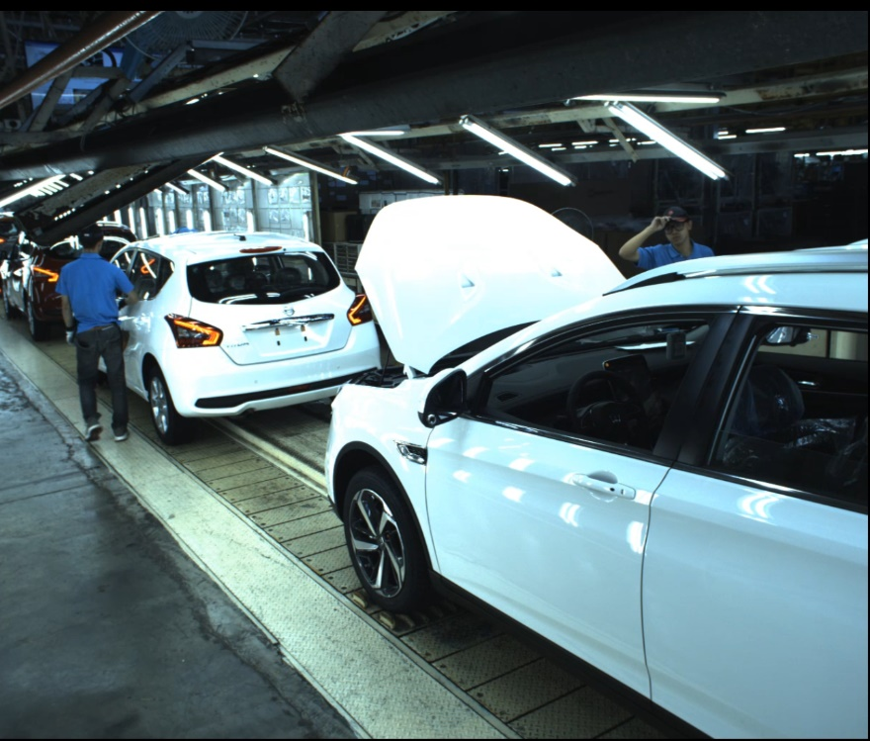
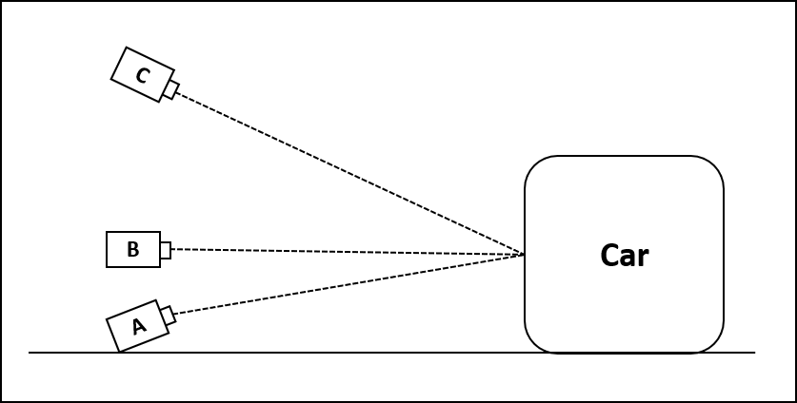
Camera Set-up
The view when the camera is installed at Location C, good angle because the effective time of a car on the car production line are long enough to detect, and the car would not be occluded by operators.

Slide 5
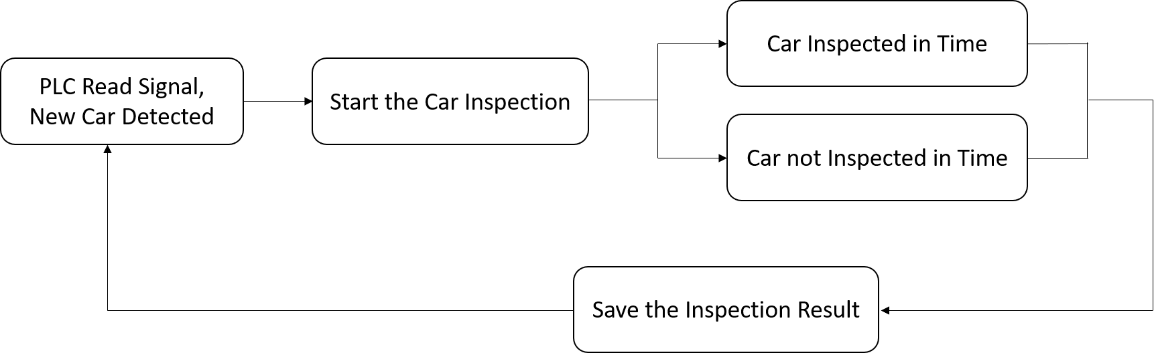
System Design and Flow
The system flow on the car production line. (PLC: Programmable Logic Controller)

Slide 6
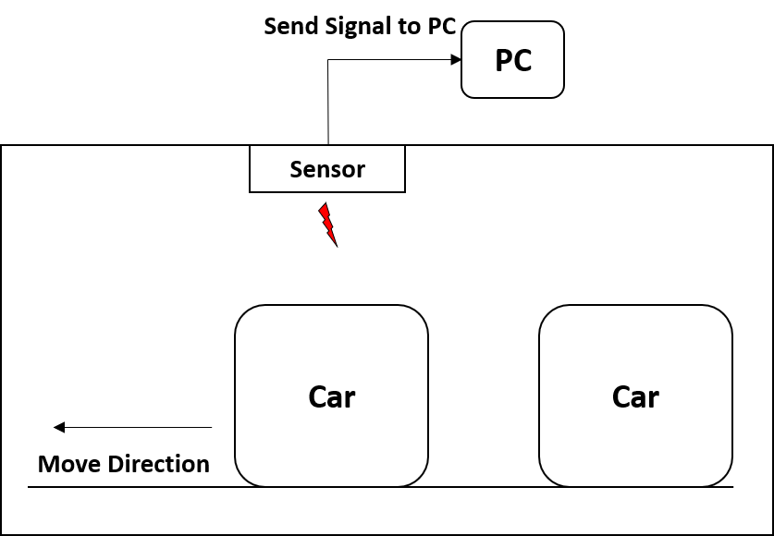
System Design and Flow
The system flow on the car production line. (PC: Personal Computer)

Slide 7
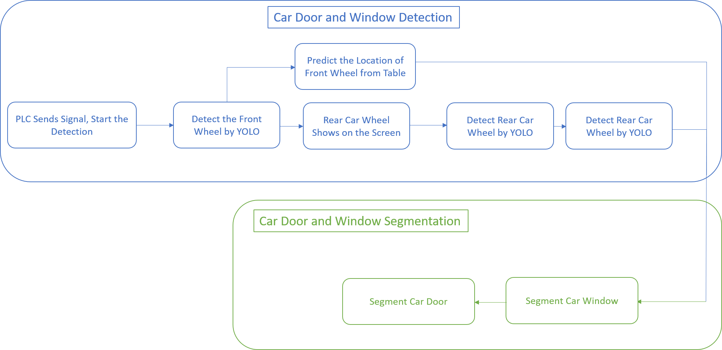
Car Door Segmentation Algorithm

Slide 8
Wheel Tracking
We compute wheel location with look-up table, so the computation will be reduced.
Because YOLOv3 may not be stable enough in each frame, our approach can guarantee to detect wheel for each frame.
On production line, YOLOv3 may fail to detect wheel. For example, wheel may be occluded by operators or opened car door.

Slide 9
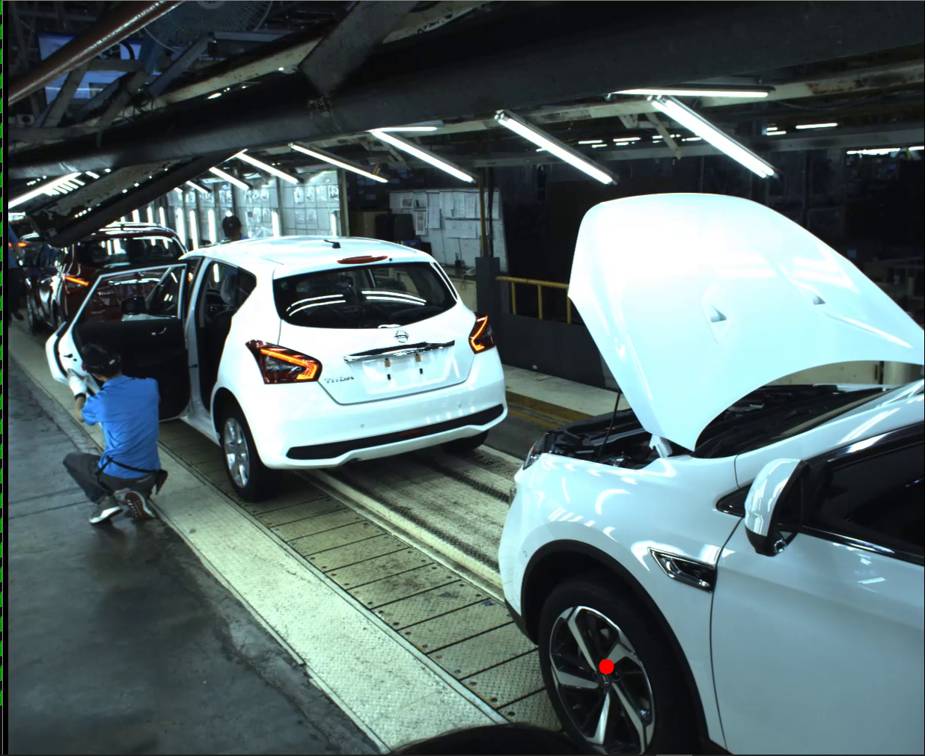
Wheel Tracking
Our algorithm finds front wheel (red point) with YOLOv3.

Slide 10
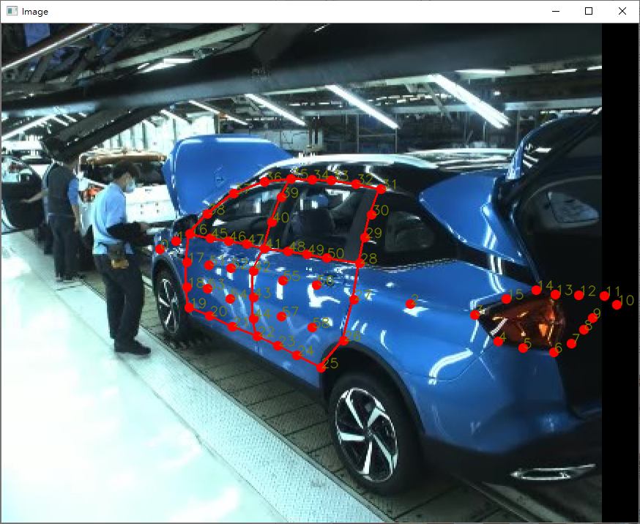
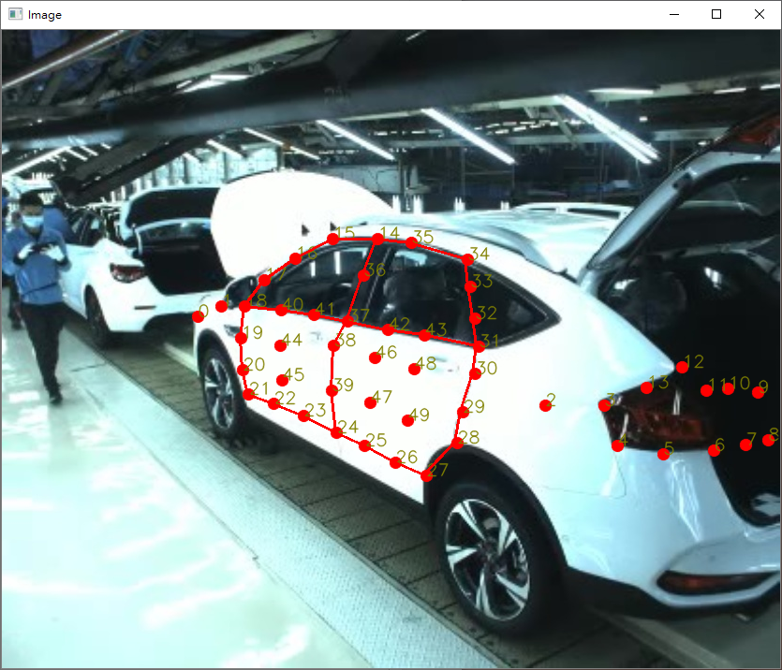
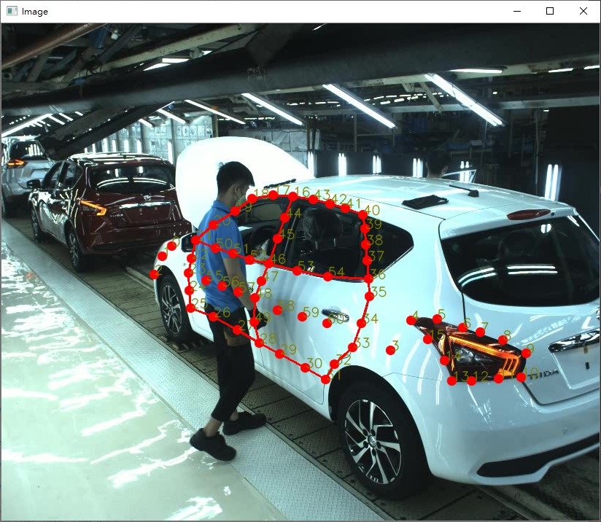
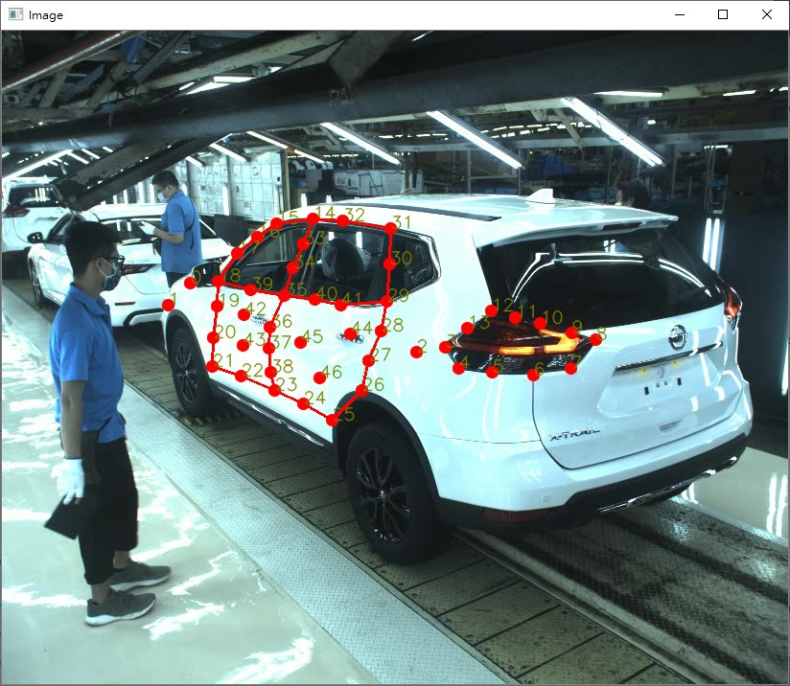
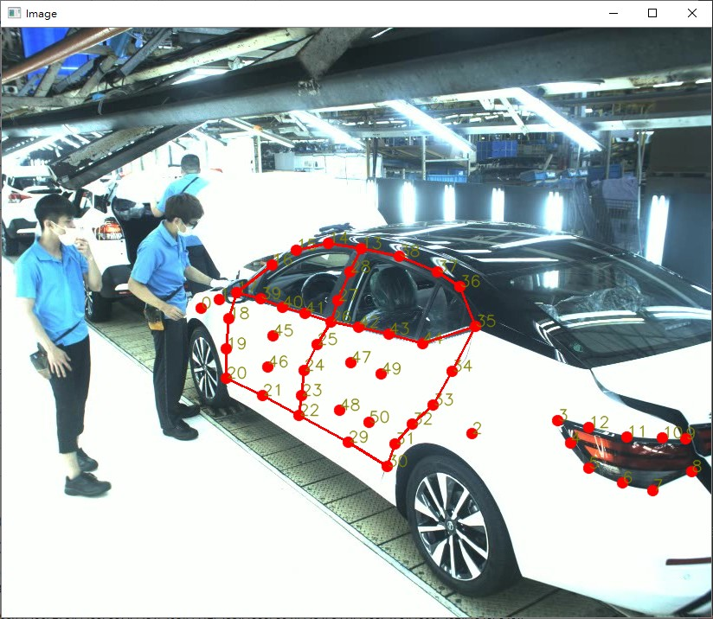
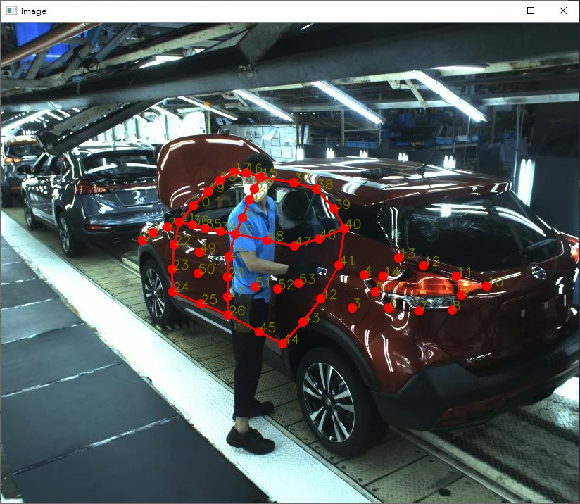
Definition of Inspection Points and Tracking
L71
C71
C12
T32
B18
P15

Slide 11
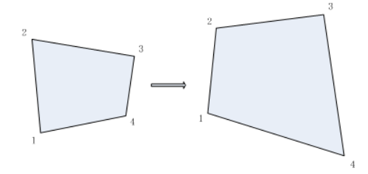
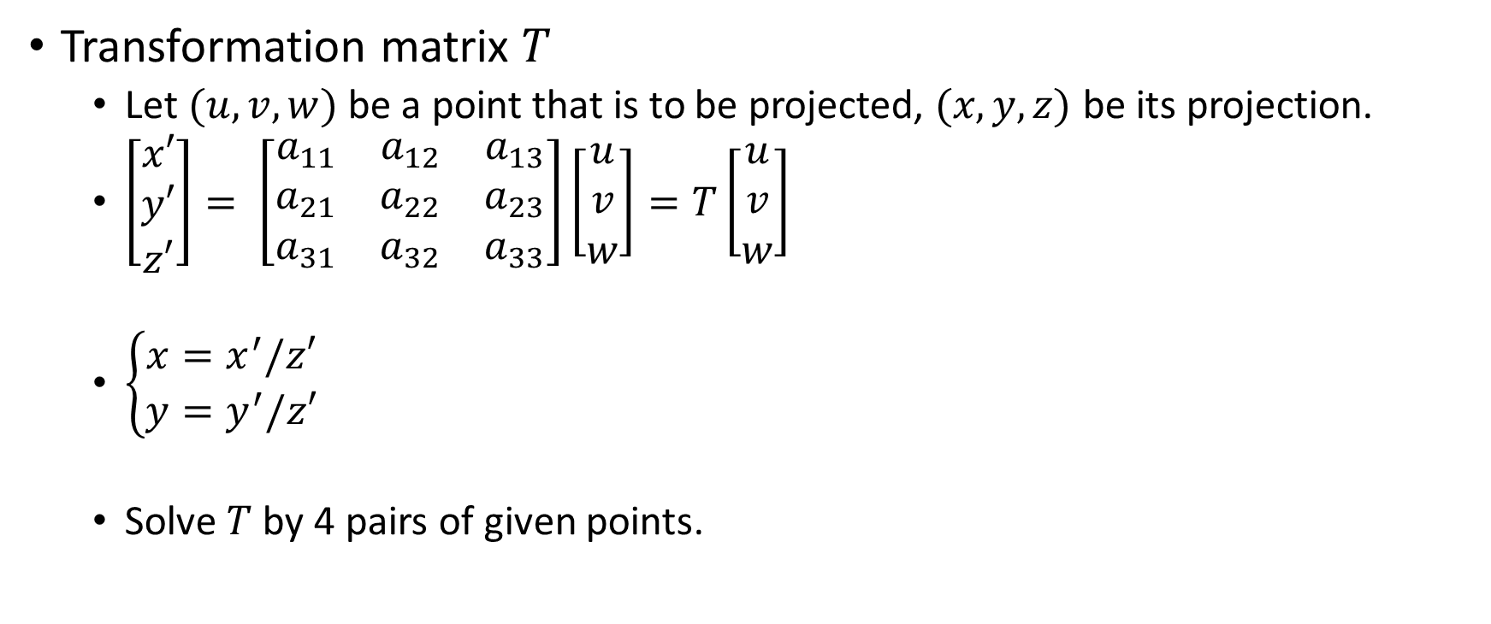
Perspective Transformation
Transformation matrix $T$
Let $(u,v,w)$ be a point that is to be projected, $(x,y,z)$ be its projection.
$\left[\begin{matrix}x′ \\ y′ \\ z′\end{matrix}\right]= \left[\begin{matrix}a_{11} & a_{12} & a_{13} \\ a_{21} & a_{22} & a_{23} \\ a_{31} & a_{32} & a_{33}\end{matrix}\right]\left[\begin{matrix}u \\ v \\ w\end{matrix}\right]=T\left[\begin{matrix}u \\ v \\ w\end{matrix}\right]$
$\left\{\begin{aligned}x=x^{′}/z′ \\ y=y^{′}/z′\end{aligned}\right.$
Solve $T$ by 4 pairs of given points.

Slide 12
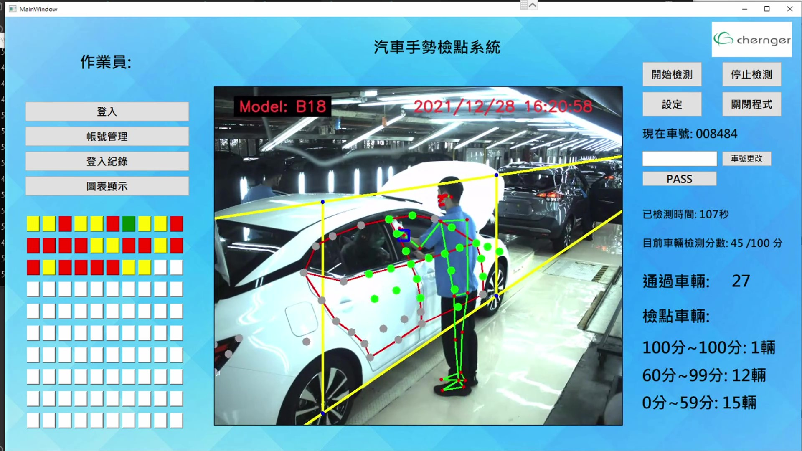
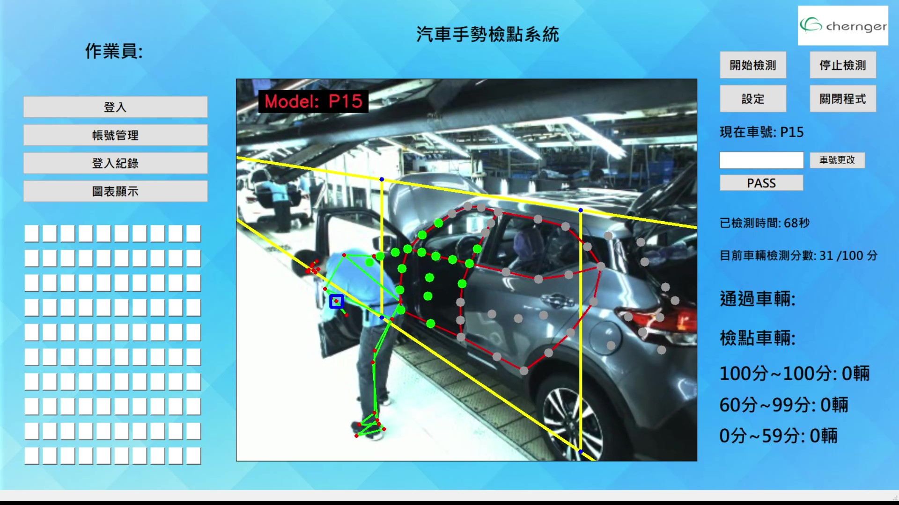
Definition of Inspection Points and Tracking
Detect the location of the car, and then project the anchors on the image.

Slide 13
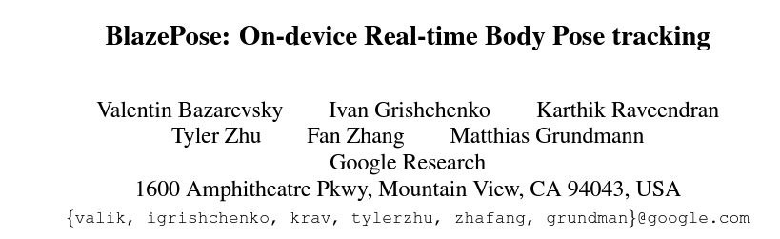
Pose Estimation
Paper: BlazePose: On-device Real-time Body Pose tracking
Author: Valentin Bazarevsky et al. Google Research
Conference: CVPR 2020
Submitted on 17 Jun 2020
https://arxiv.org/abs/2006.10204

Slide 14
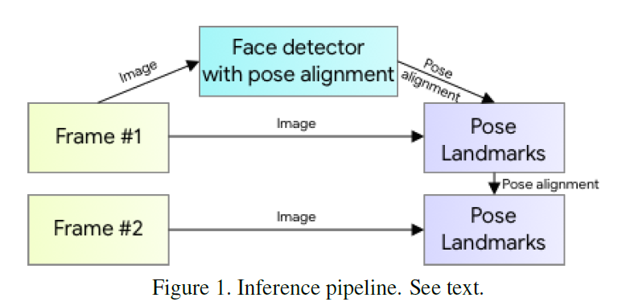
Introduction
Use an encoder-decoder network architecture to predict heatmaps for all joints, followed by another encoder that regresses directly to the coordinates of all joints.
The heatmap branch can be discarded during inference, making it sufficiently lightweight.

Slide 15
Model Architecture and Pipeline Design
Inference Pipeline:
The tracker predicts keypoint coordinates, the presence of the person on the current frame, and the refined region of interest for the current frame.
When the tracker indicates that there is no human present, we re-run the detector network on the next frame.

Slide 16
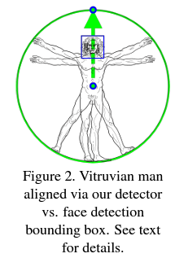
Model Architecture and Pipeline Design
Person Detector:
The majority of modern object detection solutions rely on the Non-Maximum Suppression (NMS) algorithm for their last post-processing step.
However, this algorithm breaks down for scenarios that include highly articulated poses like those of humans, e.g. people waving or hugging.
We use a fast on-device face detector as a proxy for a person detector.
This face detector predicts additional person specific alignment parameters: the middle point between the person’s hips, the size of the circle circumscribing the whole person, and incline.

Slide 17
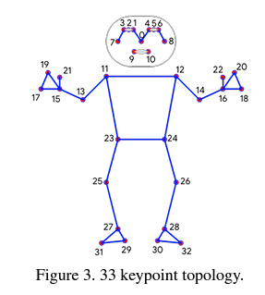
Model Architecture and Pipeline Design
Topology:
We present a new topology using 33 points on the human body by taking the superset of those used by BlazeFace, BlazePalm, and COCO.
COCO: Common Object in COntext

Slide 18
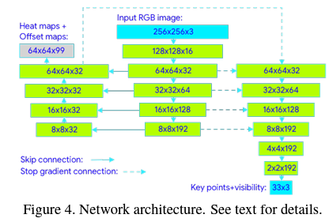
Model Architecture and Pipeline Design
Neural network architecture:
We use the heatmap and offset loss only in the training stage and remove the corresponding output layers from the model before running the inference.
We actively utilize skip-connections between all the stages of the network to achieve a balance between high and low-level features.
The gradients from the regression encoder are not propagated back to the heatmap trained features

Slide 19
RGB: Red, Green, Blue

Slide 20
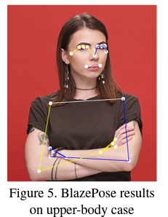
Model Architecture and Pipeline Design
Alignment and occlusions augmentation:
A relevant pose prior is a vital part of the proposed solution. We deliberately limit supported ranges for the angle, scale, and translation during augmentation and data preparation when training.
To support the prediction of invisible points, we simulate occlusions (random rectangles filled with various colors) during training.
This allows tracking a person constantly even for cases of significant occlusions.

Slide 21
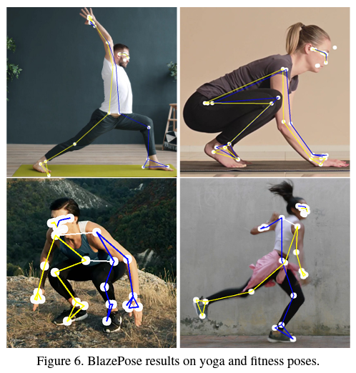
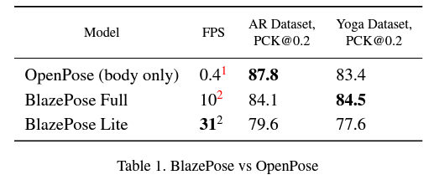
Experiments
To evaluate our model’s quality, we chose OpenPose as a baseline.
FPS: Frame Per Second
PCK@0.2: Percent of Correct Points with 20% tolerance
(Assume the point to be detected correctly if the 2D Euclidean error is smaller than 20% of the corresponding person’s torso size.)

Slide 22
End

